Slide 1
Information Asset Register Procedure
Presented By: Larry W. Wilkes II

Slide 2
Information Asset Register
Information Asset Registers are created by Information Department’s Compliance team and maintained by Information Asset Custodian (IAC) in consultation with their Information Asset Owner (IAO). Asset registers show what information assets are held and used by the team for which the IAC is responsible.
Information assets should be documented in an asset register and maintained by an IAC under the management supervision of an IAO.

Slide 3
IAO & IAC
Information Asset Owner (IAO) – An individual or entity that has management responsibility for controlling the production, development, maintenance, use and security of the asset.
Information Asset Custodian (IAC) – An individual or entity to whom routine tasks may be delegated and who is looking after the asset on a daily basis, but the responsibility lies with the owner.

Slide 4
Information Asset
Those that are central to the efficient running of departments, for example patient, finance, stock and staff data. They also include the systems, hardware and software that are used to process and store this data.

Slide 5
Asset Category
These are the types of assets or the categories the assets belong to.
Physical (Equipment or Hardware) - Equipment with processing (input, processing, output), ICT Equipment, Computer equipment (processors, monitors, laptops, modems, printers etc.), Communication equipment (Network devices, EPABX, Fax machines), Media (Tapes, Disks, CDs), etc.
Information (Digital) - Scanned or Automated format, Machine readable, Database, Data files, Operational & Support Documents, Intellectual Property Rights, etc..
Information (Hard copies/Paper) - User Manuals, License, Contracts, Agreements, Drawings, Operational & Support Procedures, etc.
Software - Application software, System software, Development tools & Utilities, Network monitoring tools etc., Software packages owned by the department (not IT Dept)
Services - This would include various business services provided by the information assets.
People/Personnel [Human Resources (HR] - personnel required to support and run other assets such as Administrators, Developers, Department/section/unit head, Support staff, etc. under the Department.

Slide 6
Asset Classification
Confidential – A concept that applies to the organization’s information assets that must be held in confidence and indicates a level of protection that must be provided to assets to prevent unauthorized disclosure.
Integrity – A concept applying to the organization’s information assets that provides assurance, under all conditions, that the asset has not been altered without authorization.
Availability – A concept that ensures the organization’s information assets will be available to authorized users when required.
Based on the sensitivity of the asset, each concept of an asset has to be rated as Low(1), Moderate(2), High(3) & Very High(4), in ascending order of the impact. The availability characteristic will depend on the downtime that can be afforded for the asset.

Slide 7
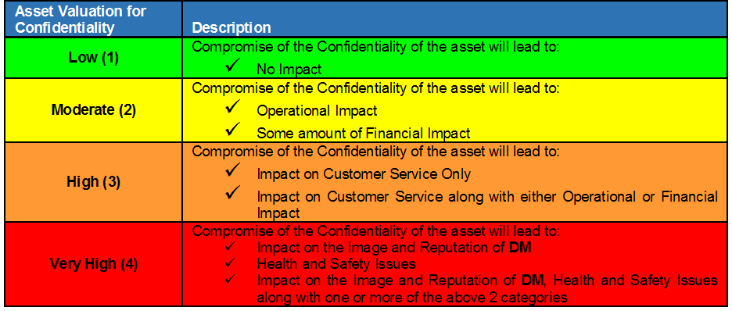
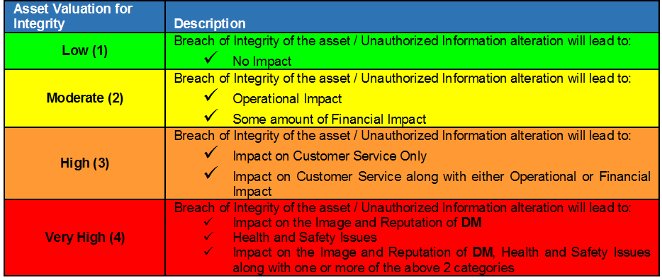
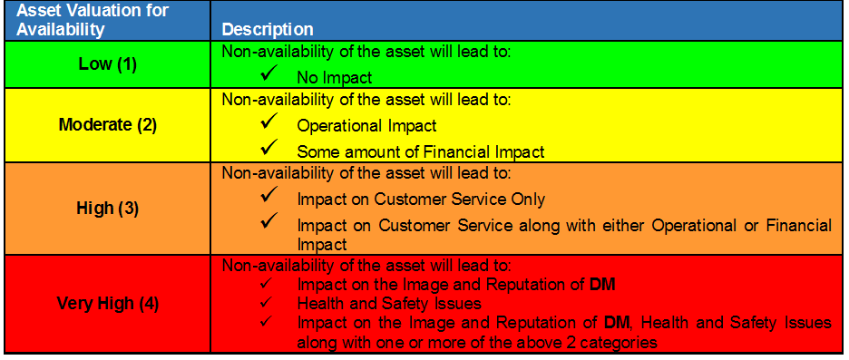
Valuation

Slide 8
Creating and Maintaining Information Asset Register
Champions, preferably two, from each department should list all the Information assets from their respective departments. Each champion will fill the information asset register with the collected asset information.

Slide 9
Information Asset Classification
Information Assets available at the DM shall be classified as Confidential, Internal and Public.
Confidential: Information that is sensitive within DM and is intended for use only by specified groups of employees or within selected department(s).
Internal: Non-sensitive information intended for distribution within DM.
Public: Non-sensitive pieces of information that are meant for release to general public.

Slide 10
Document Control
Document control is a management profession whose purpose is to enforce controlled processes and practices for the creation, modification, review, issuance, distribution, and accessibility of documents.
Ensures documentation is trusted by it’s users and that it contains up to date, reliable, checked, and formally approved information.
It is a key component of risk management in an organization, and it creates auditable records of the activities surrounding the production the exchange, and the modification of documentation.

Slide 11
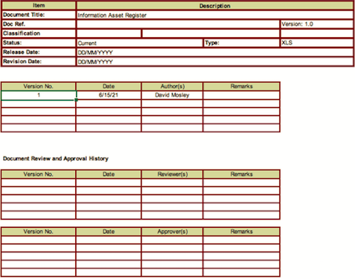
Filling out the IAR
Document Control Sheet
Update the version number
Complete Date, Author(s), and Remarks field
Complete Review and Approval History

Slide 12
THE END
Questions, Comments or Concerns Contact:
Larry Wilkes
Cybersecurity Specialist
l.wilkes@infosec4tc.com

